Slide 1
FASD Across the Lifespan: Screening, Diagnosis, and Intervention 4th Hawai’i Conference on FASD FASD Across the Lifespan: Addressing the Challenges September 15, 2023
Paul Connor, Ph.D.
Clinical Neuropsychologist Private Practice & University of Washington
Joanne Sparrow, Ph.D.
Clinical Psychologist Private Practice &
Seattle Childrens Research Institute - Families Moving Forward Program

Slide 2
True or False
Most patients with FASD are mentally retarded
FAS is more severe than pFAS/ARND
Children grow out of FASD
FASD children can’t learn from mistakes
FASD means children are born drunk
Children with FASD can’t be treated

Slide 3
Fetal Alcohol Spectrum Disorder (FASD)
FASD: Umbrella term for group of conditions
caused by maternal alcohol consumption,
which result in CNS Dysfunction.
FAS (fetal alcohol syndrome)
PFAS (partial fetal alcohol syndrome)
ARND (alcohol-related neurodevelopmental disorder)
FAE: Previous term for PFAS, ARND
ND-PAE: DSM-5 diagnosis indicating that an individual is on the FASD spectrum

Slide 4
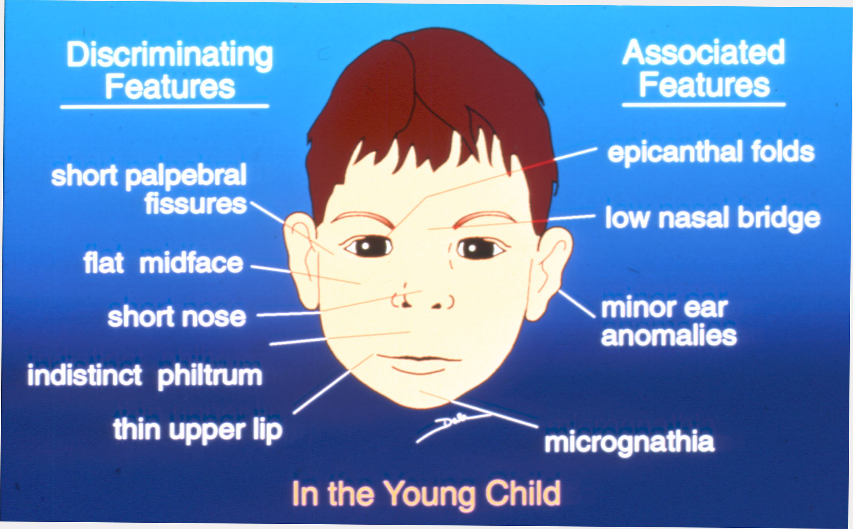

Slide 5
Alcohol is a Teratogenic Drug
Alcohol freely passes from the mother’s
blood into the fetus.
A fetus has no functioning liver early in
gestation.
Fetal brain cell death commences within
12 hours of maternal alcohol exposure.

Slide 6
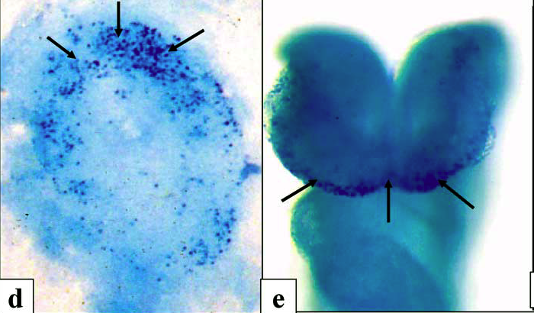
Sulik KK. Genesis of Alcohol-Induced Craniofacial Dysmorphism.
Exp Biol Med 230(6): 366- 375, 2005, Figure 4 at page 370.

Slide 7
Teratogenic Effects
of Prenatal Alcohol Exposure
Direct toxic effect of alcohol on cells
Direct toxic effect of acetaldehyde on cells
Hypoxia from impaired placental/fetal blood flow
Effect on generation and proliferation of cells
Effect on migration of cells
Effect on interconnection of cells
Effect on apoptosis

Slide 9
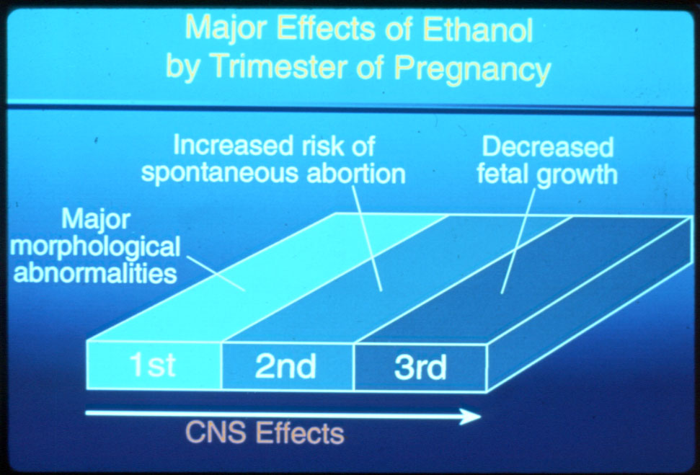

Slide 10
Impact of Alcohol on Brain and Function
Direct Effects: Prenatal exposure to alcohol damages developing cells in the Central Nervous System (CNS). This can be seen via a number of different imaging techniques.
Damage to the structure of the brain leads to…
Primary Disabilities: Cognitive or neuropsychological deficits such as memory, attention, intellectual functioning, academics, processing of information, problem solving disturbances, etc.

Slide 11
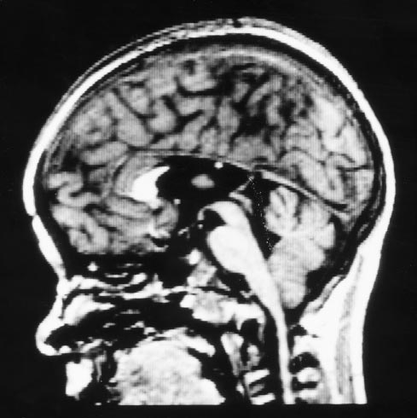
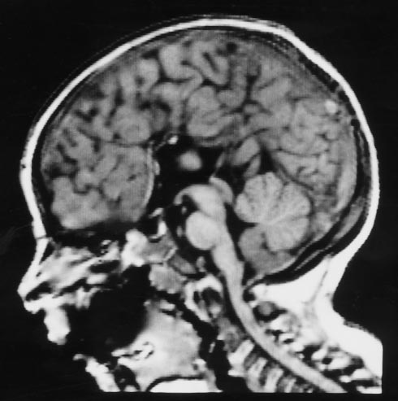
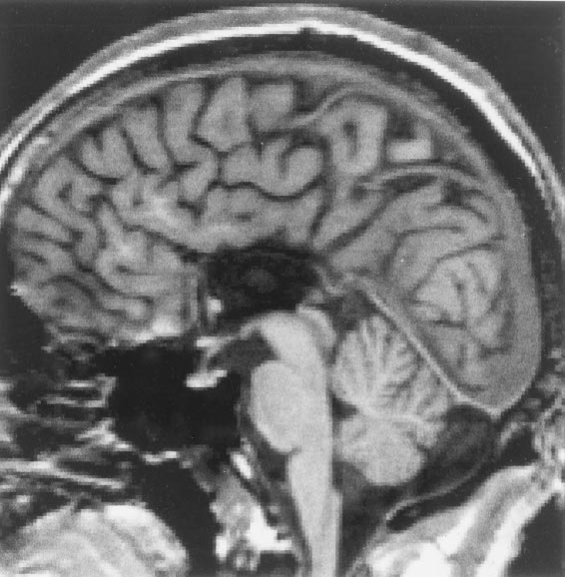
Agenesis of the Corpus Callosum
Swayze II et al., (1997). Pediatrics. 99:232-240

Slide 12
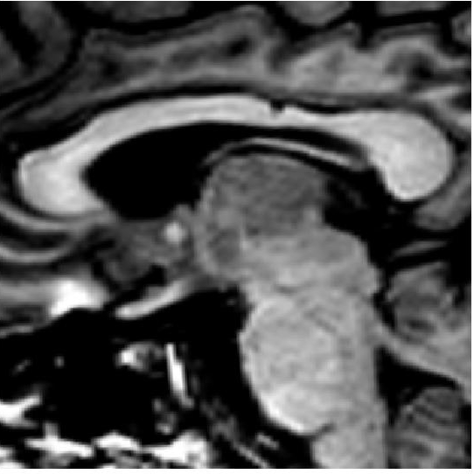

Slide 13
FASD
Normal

Slide 14
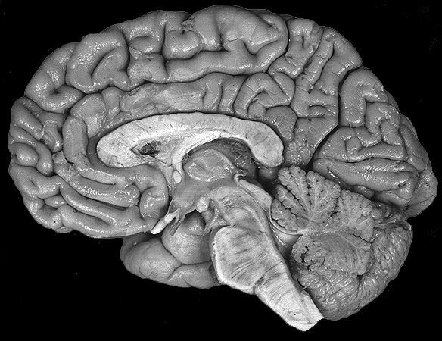
Regions of the Brain Affected by Prenatal Alcohol
Cerebral Cortex
Cerebellum
Corpus Callosum
Olfactory Bulb

Slide 15
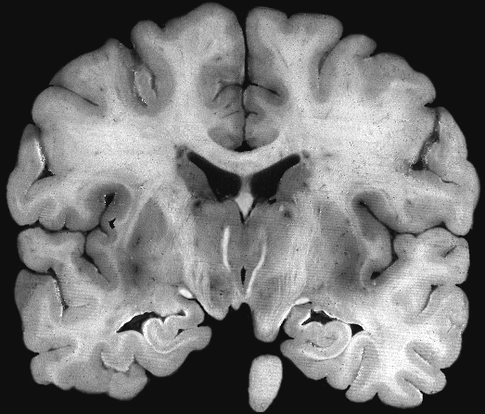
Regions of the Brain Affected by Prenatal Alcohol
Caudate Nucleus (head)
Ventricle
Hippocampus

Slide 16
Means, McDaniel, Pennington (1989) Alcohol

Slide 17
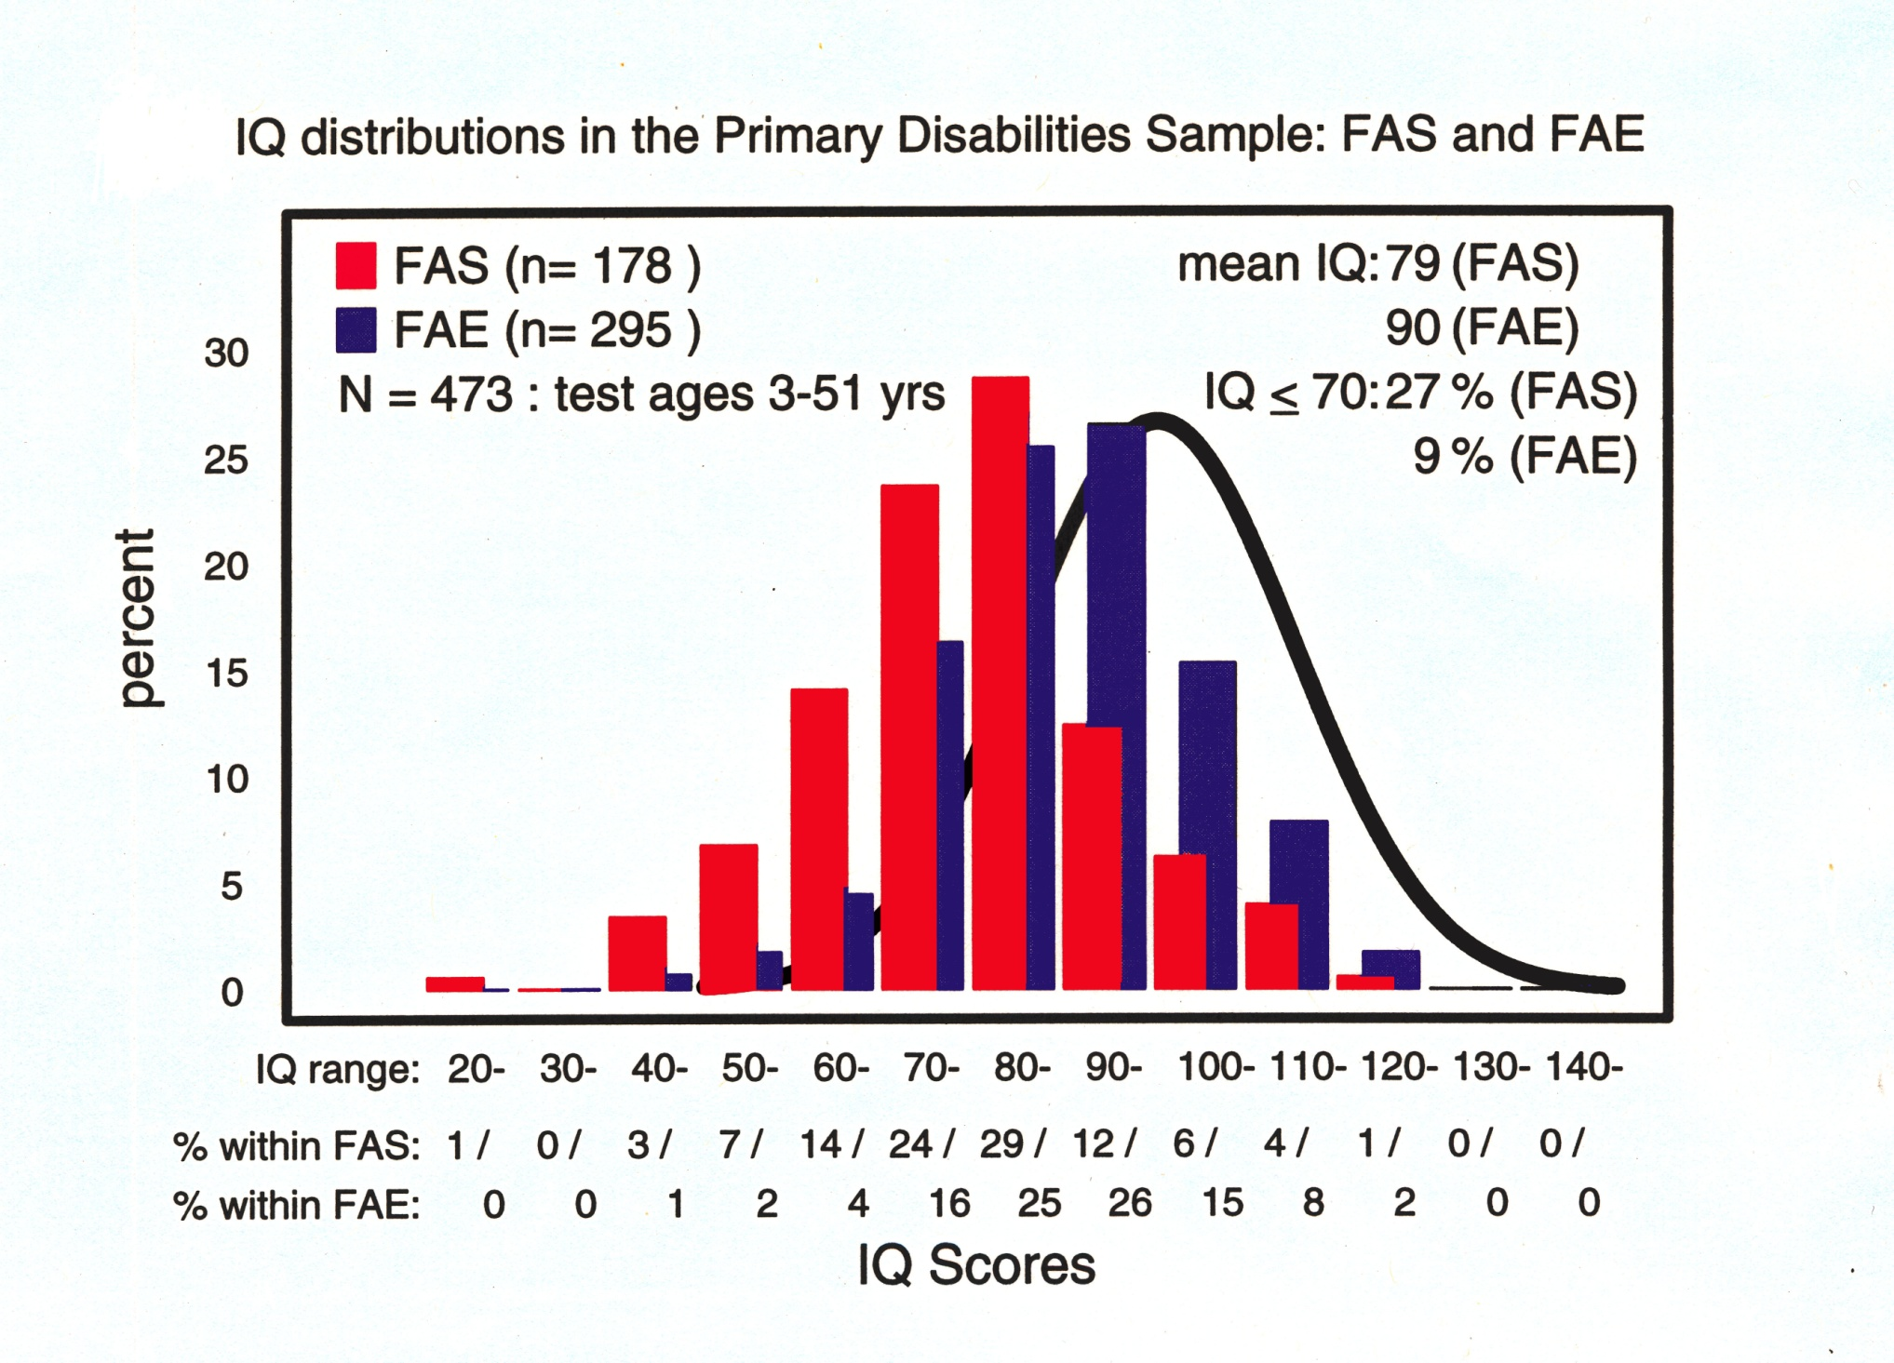

Slide 18
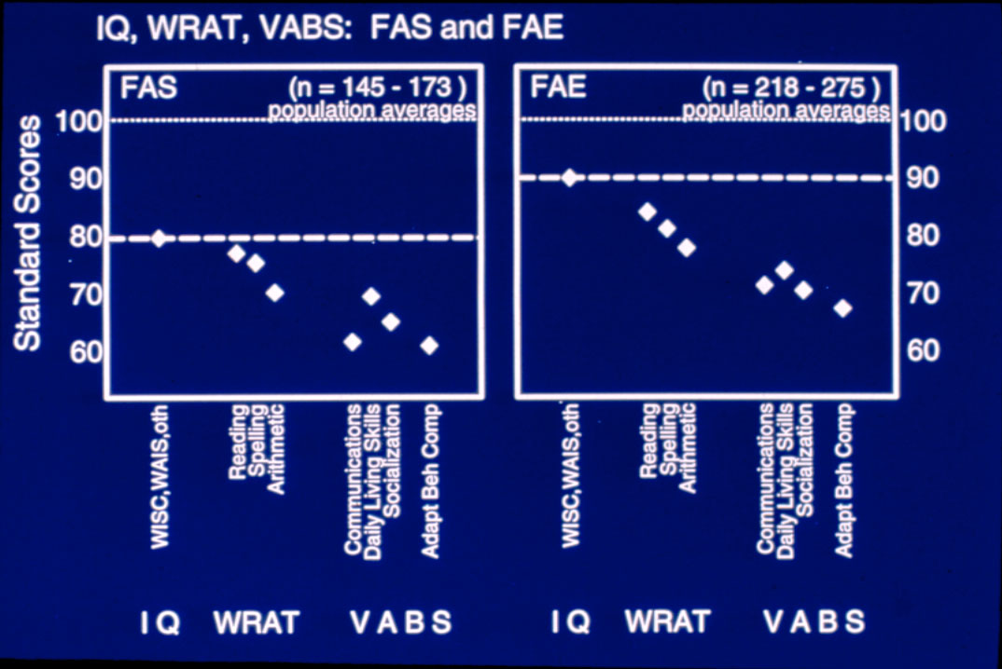

Slide 19
Red Flags/Screening

Slide 20
Red Flags in Records: Childhood
Prematurity / birth complications / seizures
Developmental delay (e.g., motor skills)
Early speech and language problems
Learning disabilities / SPECIAL EDUCATION (school testing very helpful)
Academic problems in school
Behavior problems in school and elsewhere
Mental health diagnoses prior psychological neuropsychological evaluations

Slide 21
Red Flags in Records: Adolescence
School failure, disruption
Mental health problems
Substance abuse
Sexually inappropriate behavior
Inability to fit in with age-peers
Ongoing self-regulation problems (viewed by adults as volitional)

Slide 22
PREVALENCE OF SECONDARY DISABILITIES
Across the Life Span
100
90
80
70
60
50
40
30
20
10
Ages 6 - 51
Ages 21 - 51
%
Mental Health Problems
Trouble With the Law
Inappropriate Sexual Behavior
Dependent Living
Disrupted School Experience
Confinement
Alcohol & Drug Problems
Problems with Employment
Ages 6-51 (n=408-415) Ages 21-51 (n=89-90)
Notes:
22

Slide 23
Only 7 of 90 adults with FASD were able to live independently and without major employment problems

Slide 24
From “The Lay of the Land” by Himmelreich, Lutke & Hargrove
Thinking about FASD as a “whole body diagnosis”
Immune disorders
Autoimmune disorders
Cardiovascular system issues
Musculoskeletal issues
Vision/hearing issues
Reproductive health challenges
Endocrine/metabolic disorders
Sleep disorders
Mental health disorders

Slide 25
Screening Materials

Slide 27
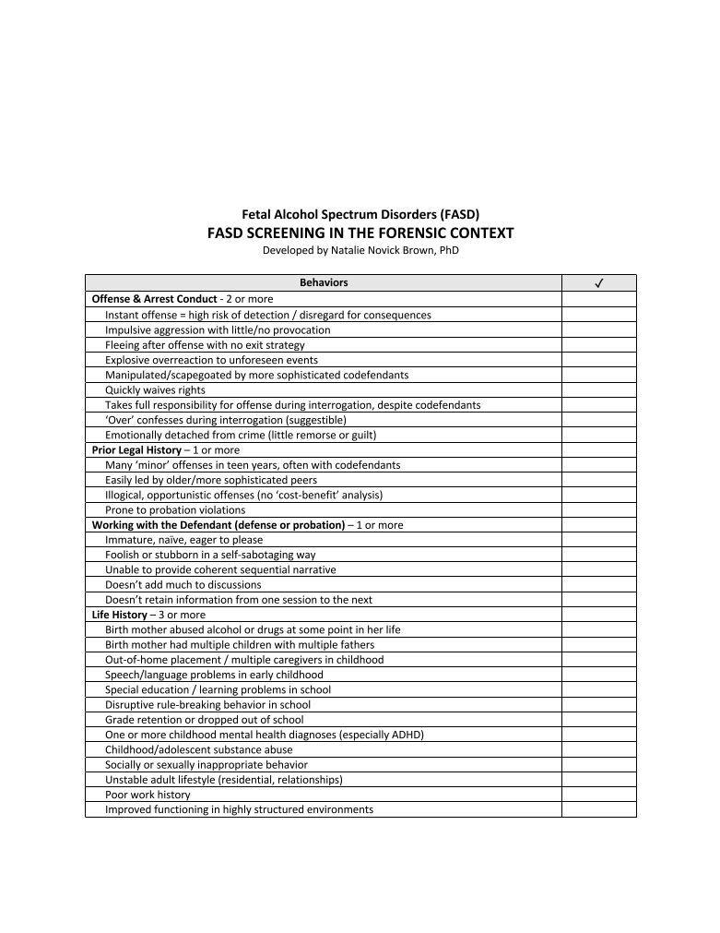

Slide 28
Jane
24 year old, right-handed Caucasian female
Single mother
Full custody of youngest son
Unemployed
Intensive in-patient drug treatment program
Referral question
Neuropsychological functioning
Possible FASD?

Slide 29
History of Presenting Complaints
Anxious to “start my life” by gaining an understanding of “what is going on in my head”
Feels that “something is wrong … which is preventing me from being able to be like others”
Long-standing problems across several domains
attention and concentration
learning and memory
expressive and receptive language
problem solving

Slide 30
Education and Employment
Jane reported that she “struggled a lot” throughout grade school years
Individualized Education Plan (IEP) developed
special education classes by the time she was in 3rd or 4th grade
doing “hands on” work in a one-to-one situation was very helpful
dropped out of school in 6th grade to be homeschooled
classroom experiences felt “very unsafe” due to teasing
has made at least two unsuccessful attempts to return to complete her GED
Employment
service-level jobs
courtesy clerk
stocked grocery store freezers

Slide 31
Substance Abuse History
Alcohol use
began drinking at the age of 20; within a year, was consuming hard alcohol daily
Other drugs
Ecstasy and Methadone
methadone helped to “blank things out” and “made me feel normal so that I didn’t think about anything”.
Methamphetamine was drug of choice
Using 2 grams/day for period of 6 months
Smoking/snorting/injecting
denied use of all other illegal or legal substances
drug use has resulted in several contacts with the law, including a two-week jail sentence and a charge for possession of marijuana

Slide 32
Current/Past Psychiatric History
Felt depressed as a child
has struggled with depression daily for many years as an adult
Currently taking Celexa (20 mg/day)
Reported times when she will feel happy and then begin to feel “really crappy”
behaviors do not appear to be related to any kind of manic episode
Self-regulation?
Becomes anxious in large crowds and when around new people
becomes hot and sweaty and feels like she is going to pass out
Denied experiencing hallucinations, delusions and/or paranoid ideation
No current suicidal or homicidal ideation
Problems with sleep
impacted by stress

Slide 33
Neuropsychological Assessment for Diagnosis of an FASD

Slide 34
Multiple FASD Diagnostic Systems
System | Criteria
IOM/CDC | IQ <-2sd OR Neuropsych <-1sd in 3 domains
UW FASDPN | IQ <-2sd OR Neuropsych <-2sd in 3 domains
Canadian Guidelines | IQ <-2sd OR Neuropsych <-2sd in 3 domains
Hoyme et al. | IQ <-1.5sd OR Neuropsych <-1.5sd in 1 domain Behavioral <-1.5sd Developmental Delay <-1.5sd
DSM-5 (Neurobehavioral Disorder) | Deficit in domains of: Neurocognitive Function Self-Regulation Adaptive Function

Slide 35
EXPECTED NEUROPSYCHOLOGICAL FINDINGS
Alcohol nonspecific teratogen
Effects depend on timing and dose
Similar effects with drinking at different times
Rarely see IQ below 70 but often splits across domains
“Patchy” presentation rather than global or focal deficits
Academic deficits especially in arithmetic
Often Visuospatial Construction impairments
Often Attention/Impulsivity impairments
Social/Adaptive functioning deficits
Executive function deficits
Highly Suggestible
Increased variability in performance

Slide 36
Battery for FASD Cases
IQ (WAIS-IV)
Achievement (WRAT-4)
Visual Spatial Construction (RCFT)
Learning and Memory (CVLT, RCFT)
Attention (CPT)
Motor Coordination (Grooved Pegs, Finger Tap)
Executive Functions (WCST, DKEFS, COWAT, RFF, Stroop, ACT, Trails)
Auditory Comprehension (NAB)
Social Cognition (ACS)
Suggestibility (GSS2)
Adaptive Functioning direct assessment (TFLS)
Adaptive behaviors assessing 3 domains of functioning (Vineland Adaptive Behavior Scale VABS)

Slide 37
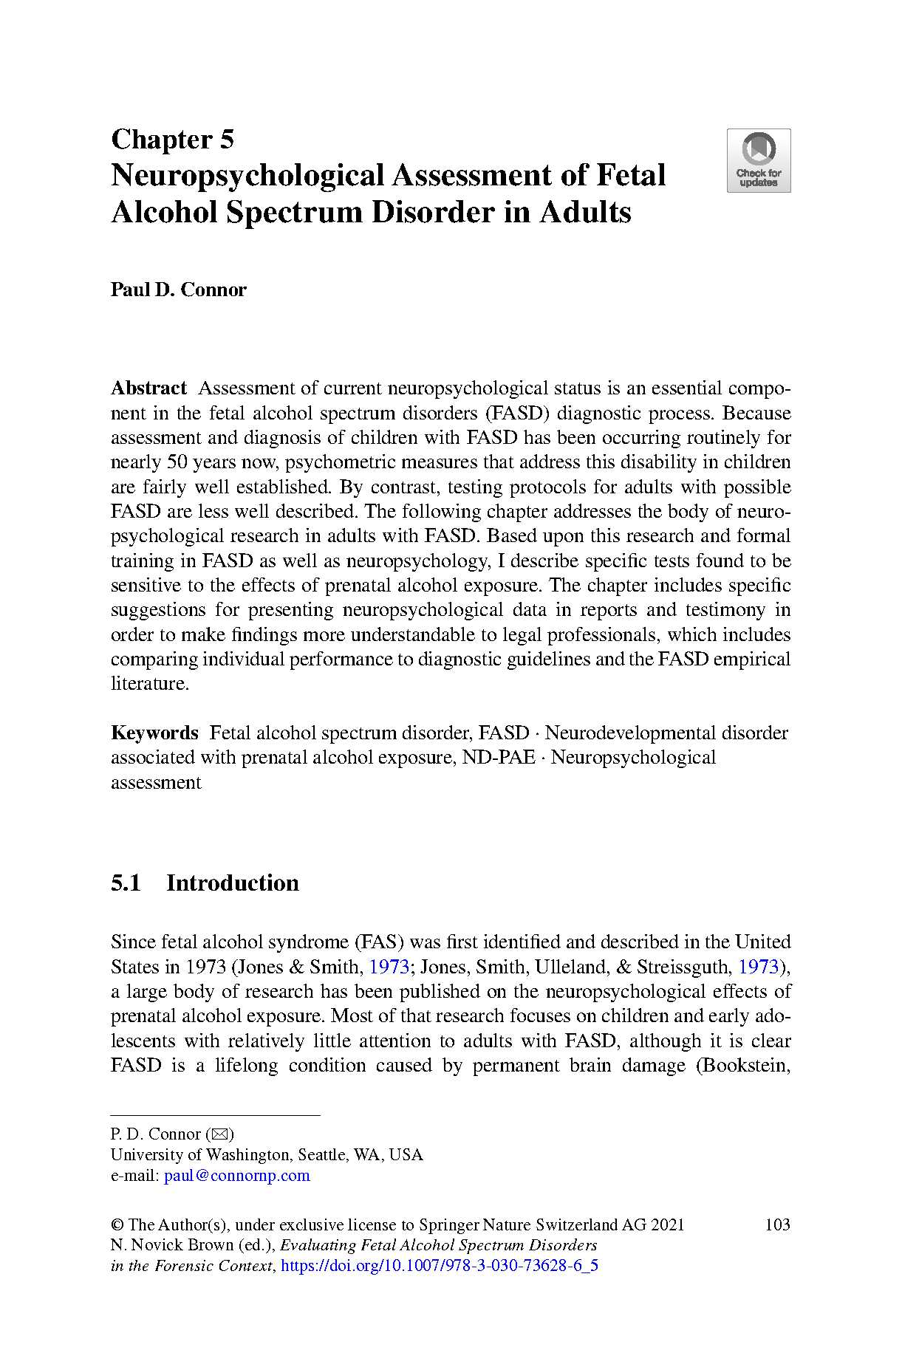

Slide 38
Neuropsychological Testing
Visuospatial
Processing Speed
IQ
Academics
Memory
Attention
Motor
Executive Function
Adaptive Function
High Structure
Low Structure
Direct
Informant
Standard Deviations (mean = 0, sd = 1)
Suggestibility

Slide 39
Jane

Slide 40
Neuropsychological Testing of Jane
Processing Speed
Academic
Visual/Spatial
Attention
IQ
Memory
Motor
Executive Function
Mental Health
Standard Deviations (mean = 0, sd = 1)

Slide 41
Diagnostic Impression
AXIS I: | Cognitive Disorder NOS (294.9)
 | Learning Disorder NOS (315.9)
 | Dysthymic Disorder with Early Onset (300.4) – provisional
 | Panic Disorder with Agoraphobia (300.21) – provisional
 | Generalized Anxiety Disorder (300.02) – provisional
AXIS II: | Diagnosis Deferred
AXIS III: | Alopecia (704.00)
AXIS IV: | Educational problems (academic problems; possible nonverbal learning disability); occupational problems (concerns about finding gainful employment upon completion of in-patient treatment program); economic problems (inadequate finances; short-term extension of TANF benefits required)
AXIS V: | Current GAF: 52

Slide 42
The Challenges of Assessing Adults for FASD
It is NOT the neuropsychological evaluation itself
It IS confirming prenatal alcohol exposure, especially as the individual gets older
It IS obtaining the records/reports that confirm cognitive challenges from an early age (that predates other possible causes such as TBI, substance use, etc.)

Slide 43
Intervention Across the Lifespan
Stages of Human Development: What It Is & Why It’s Important (maryville.edu)

Slide 44
Agenda
Learning to “see things differently”
Brief reminder re: cognitive skills impacted by PAE
The importance of …
Magic Keys
Thinking about intervention across the lifespan
The “big picture”

Slide 45
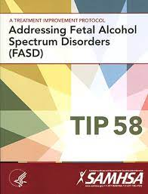
Cultural Humility & Provision of Care
“Individuals from all cultural backgrounds deserve respect and attention in a treatment environment, and the significance of culture needs to be recognized in relation to many different areas of a person's life [including] race, ethnicity, gender, sexual orientation, age, socioeconomic status, religious/spiritual orientation, language, etc.”

Slide 47
Seeing things differently …

Slide 48
Shifting Our Perspective
Won’t
Bad… annoying
Lies
Immature
Trying to get attention
Doesn’t try
Mean
Can’t
Frustrated … challenged
Tells stories → memory gaps
Is developmentally younger
Needing contact/support
Exhausted/can’t get started
Defensive/hurt
With thanks to Heather Carmichael Olson, PhD, Diane Malbin, MSW and Natasha Reid, PhD

Slide 49
1.
Using a neurodevelopmental perspective
Reframing
Brainstorming
Accommodations and Supports
Carmichael Olson (2010)

Slide 50
The ABCs of Behavior
Antecedents/Setting events
Behavior
What is the function of the behavior?
To get something?
To avoid something?
Is a sensory need being met?
Consequence
How do we find “the better way” a need to be met?
Carmichael Olson (2010)
A Look at The ABCs of Transforming Education | Clearinghouse Today Blog (studentclearinghouse.org)
Notes:
Understanding The Antecedent Behavior Consequence Model | BetterHelp

Slide 51
2.

Slide 52
3. Cognitive Supports Framework
Understand
Think Ahead
Adjust Expectations
Shift Approach
Plan Together
Sheets (2023)

Slide 53
Cognitive Skills include…
Verbal-language processing
The ability to process and understand language
Processing speed
The time it takes to perceive, process and respond to information
Working memory (aka short-term memory)
The ability to store and manage information for a short period of time
Attention span
The length of time one can concentrate on an activity/task
Impulse control
The ability to manage/control one’s emotions or behaviors
Planning and problem solving
The process of defining a problem, determining its cause, and implementing a solution
Memory
The storage, retention and retrieval of information
Cognitive/emotional regulation
The ability to engage executive functioning skills
Sheets (2023)

Slide 54
Utilizing the Cognitive Skills Filter
Sheets (2023)

Slide 55
The Importance of Regulation
Green Pathway
Regulated
Red Pathway
Fight or flight mode
Blue Pathway
Unable to engage
Unresponsive
Wandering
Escalated
Defensive
Oppositional
Angrily avoidant
Feeling safe
Able to engage socially
Able to recover quickly after encountering small stressors
Overwhelmed
Shut down or frozen
Physical
Delahook (2019); Sheets (2023)
Notes:
Doing all we can to keep ourselves grounded in the Green pathway
Dipping into red – fight or flight
Blue – freeze
If you as a care provider can’t regulate your emotions, chances are you cant help coregulate your client

Slide 56
The Importance of Safety and Connection
Neuroception and trauma
Safe vs. Unsafe
Self-regulation and co-regulation
Soothe
Co-regulate
Think into self-regulation
Connection and safety
Sheets (2023)
Notes:
Regulation impacts the ability to be safe and have connection
So many individuals with FASD have significant trauma histories, it’s important to understand that people need to feel safe in relationships, in environments, in order to do ANYTHING. Growing requires safety.
You as a provider, being able to manage our own emotional responses, self-regulating → now you can support co-regulation
Safe and connected = moving forward

Slide 57
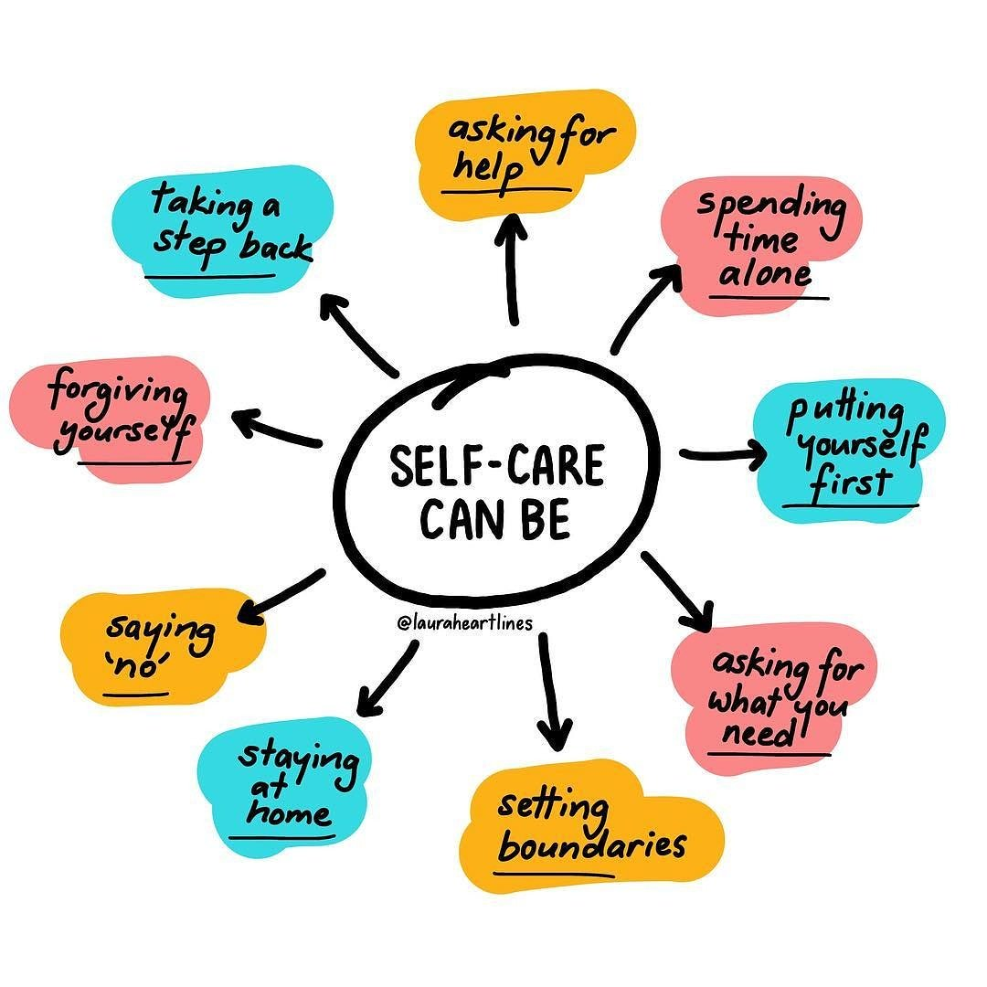
The Importance of Self-Care
Be kind/extend grace to yourself
Learn ways to manage your stress
Prioritize respite
Seek supportive relationships
Permission to say “no” at times
It’s okay to step away
Focus on your sphere of influence
Schedule self-care
Spiller (2020)
Self-care: Develop a Routine That Works For You. | SoundGirls.org

Slide 58
The Magic Keys and Intervention
Concrete
Consistent
Reduce distractions
Regulation
Repetition/reminders
Routine
Show
Simplicity
Slow down
Specific
Structure
Supervision
Fasalaska Project FACTS – Evensen & Lutke (1997)
magic keys - Bing images

Slide 59
Applying the Magic Keys
Verbal-language processing
The ability to process and understand language
Concrete
Simple
Specific
Processing speed
The time it takes to perceive, process and respond to information
Slow down
Repetition
Working memory (aka short-term memory)
The ability to store and manage information for a short period of time
Reduce distractions
Repetition
Evensen & Lutke (1997); Sheets (2023)
google images - plastic brain - Bing images
Notes:
Magic Keys inform how we create accommodations across different cognitive domains
Think about the brain thing to inform how we change our behaviour and responses

Slide 60
Applying the Magic Keys
Attention span
The length of time one can concentrate on an activity/task
Reduce distractions
Simple
Impulse control
The ability to manage/control one’s emotions or behaviors
Consistency
Regulation
Routine
Structure
Supervision
Evensen & Lutke (1997); Sheets (2023)
google images - plastic brain - Bing images

Slide 61
Applying the Magic Keys
Planning and problem solving
The process of defining a problem, determining its cause, and implementing a solution
Concrete
Simplicity
Specific
Supervision
Memory
The storage, retention and retrieval of information
Reduce distractions
Repetition
Routine
Simplicity
Specific
Evensen & Lutke (1997); Sheets (2023)
google images - plastic brain - Bing images

Slide 62
Adulthood
18+ Years
Changing Relationships in Late Adulthood (secondwindmovement.com)

Slide 63
“Research hasn’t caught up with what’s happening in practice – clinicians and service providers are adapting their approaches and interventions to support their adolescent and adult clients.”
Natasha Reid, personal communication (08.09.23)

Slide 64
Interventions: Adulthood
Practical support
Employment
Financial
Housing
Mental Health
Medical
Lifestyle
Skills development
Parenting
Case Management
Advocacy
Notes:
Natasha commented that “nothing specific has been developed for this age group”
Case management is the approach most recommended in addition to practical support and advocacy
Clinical wisdom for adult interventions
Practical support across life domains
If possible, offering case management
Advocating

Slide 65
For Jane …
Practical support
Employment
Financial
Mental Health
Skills Development
Case Management
PCAP
Advocacy
Neuropsychological report and feedback

Slide 66
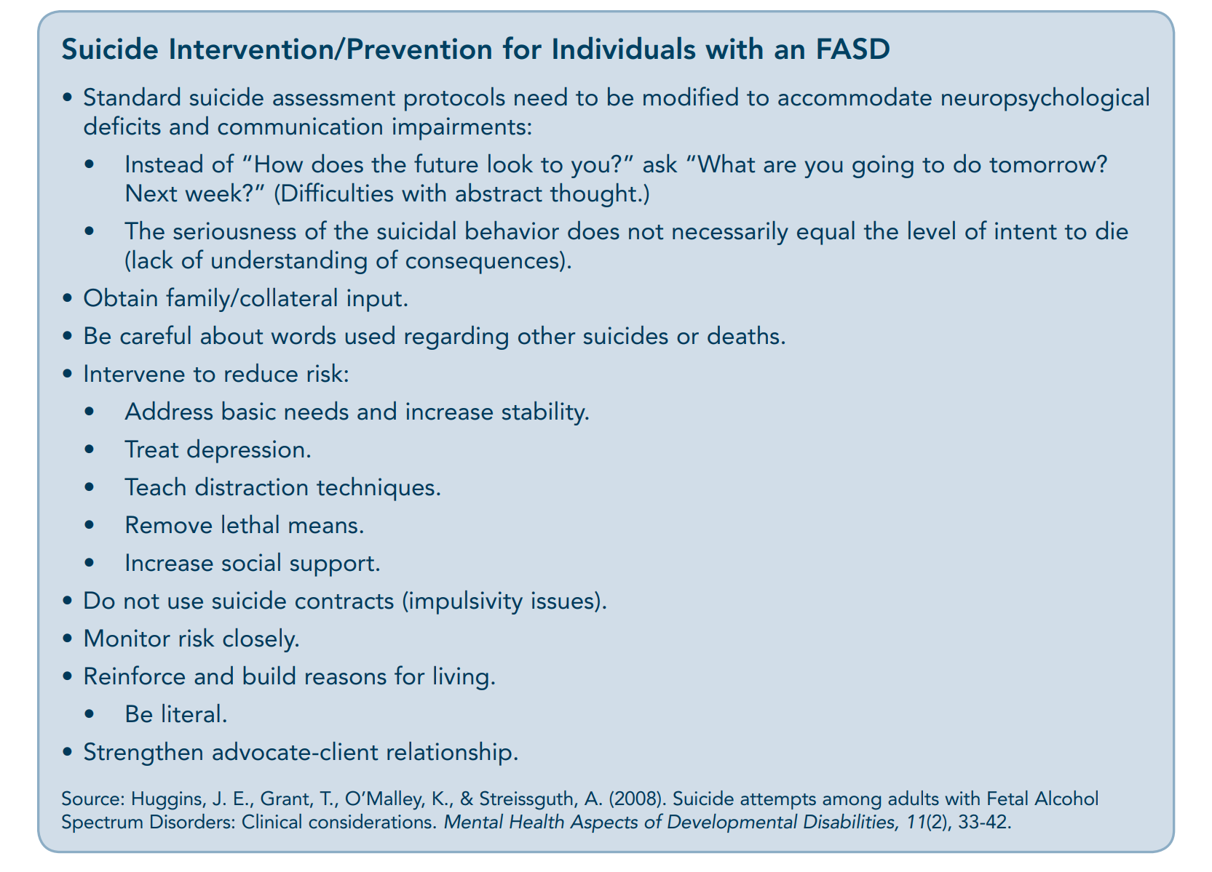
TIP 58

Slide 67
Early Years
Birth to Preschool
https://www.teachearlyyears.com/enabling-environments/view/why-its-important-to-bring-diversity-into-early-years-settings

Slide 68
Infancy: Common Characteristics
Unsettled & difficult to comfort; high-pitched cry
Irregular sleep patterns re: wake/sleep cycles
Failure to thrive &/or regular infections
Issues with feeding
Atypical eye contact &/or dislike physical contact
Over-sensitivity/under-sensitivity to the environment
Catterick & Curran (2014); Grafe (2004)
Notes:
Mention that there are a lot more, but not everyone will know them – especially people working on their cases (i.e. judges, social workers, etc.)
Signs of withdrawal
Variable patterns of alertness (passive/over-active)
Unsettled & difficult to comfort; high-pitched cry
Irregular sleep patterns re: wake/sleep cycles
Failure to thrive &/or regular infections
Issues with feeding
Gross motor delays
Unusual movement patterns (e.g., no attempt to crawl; shuffling on bottoms)
Absence of babbling/speech delays/unclear speech
Atypical eye contact &/or dislike physical contact
Lack of response/over-responding to pain
Over-sensitivity/under-sensitivity to the environment
Continuation of the startle response beyond 4-5 months

Slide 69
Early Childhood: Common Characteristics
Continued pattern of delay
Subtle differences that become more noticeable in groups
Sensory issues (including food)
Struggles with understanding things the peer group may have mastered
Tantrums/volatility
Peer relationship
Sleep routines
Communication
sleeping child - Bing images
Notes:
Quality of the parent attachment is very easy to go offline → child isn’t “easy”, hard to bond/attach
How do I stay in green to keep a strong relationship with my child? Go back to self care!
Prevent multiple disrupted placements → multiple parent figures, lots of movement

Slide 70
Protective Factors
Early diagnosis
Involvement in special education and social services
Loving, nurturing and stable home environment
Absence of violence
FASDs: Treatments | CDC

Slide 71
What could we have offered Jane?
A soft and gentle approach because of increased sensitivity to the environment
Identify what upsets/calms baby
Control the amount of stimulation baby is exposed to
Avoid letting baby get to state of frantic crying through calming techniques → gentle motion/calming sounds/warm baths
Create a bedtime routine
Home visiting program to support mom and baby
Help mom maintain relationship with Jane’s pediatrician

Slide 72
Childhood
5-12 years of age
https://allianceforchildhood.org.uk/

Slide 73
Childhood: Common characteristics
Difficulty learning from experience
Difficulty understanding cause and effect relationships
Poor judgment/Failure to perceive danger
Attention problems/hyperactivity/Impulsivity
Difficulty reading social cues
Academic problems
Deficits in executive functioning even in the presence of a normal IQ
Social skills deficits
Laugeson et al (2011)
Notes:
Difficulty learning from experience
Difficulty anticipating consequences
Difficulty understanding cause and effect relationships
Poor judgment
Failure to perceive danger
Attention problems/hyperactivity
Impulsivity
Difficulty reading social cues
Academic problems
Deficits in executive functioning even in the presence of a normal IQ
Social skills deficits

Slide 74
What could we have offered Jane?
Attention/concentration
Use ear plugs to screen out noise/headphones to focus noise
Difficulty understanding course material
Introduce one instruction/sentence/learning step at a time → check and reinforce before moving to the next step
Invite child to repeat back so that you can check for understanding
For some children, the harder they try the less they can do →brain breaks
Feeling “unsafe” because of bullying
Rehearse scenarios re: what to say/what to do
Intervention at the classroom level re: being a good friend
Monitor self-esteem/mental health

Slide 75
In general, it helps to
Use concrete language
Speak slowly and use fewer words
Use the same words each time
Be specific
Provide external memory tools
Expect to re-teach material
Maintain routine to decrease anxiety
Eliminate clutter in the environment and keep things organized
Allow for ways to filter out distractions
Bluegrass Prevention Center: The Sycamore Project

Slide 76
Do2Learn: Educational Resources for Special Needs
https://do2learn.com/academics/Mathematics/index.htm

Slide 77
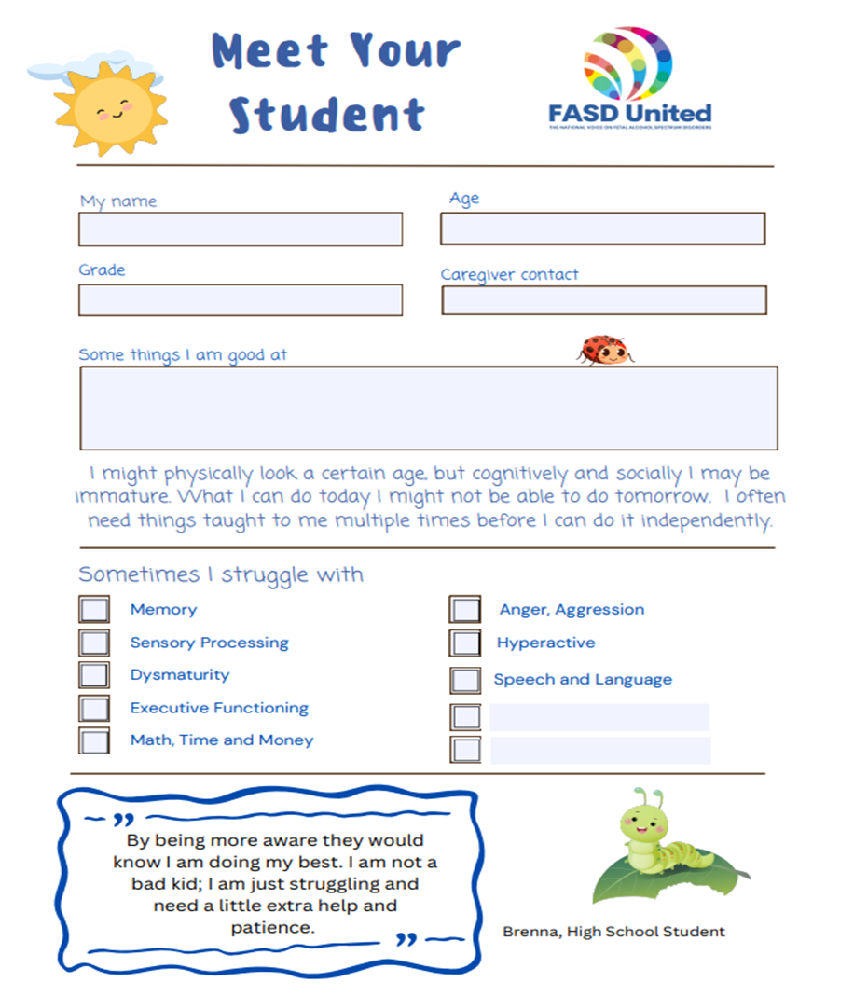

Slide 79
Wrightslaw Special Education Law and Advocacy

Slide 80
Middle School

Slide 81
Be alert to…
anxiety middle school - Bing images

Slide 82
What could we have offered Jane?
Home environment
Sleep
Promoting personal skills
Social/communication skills & self-esteem
Managing change and transitions
In the community
Dealing with outbursts

Slide 83
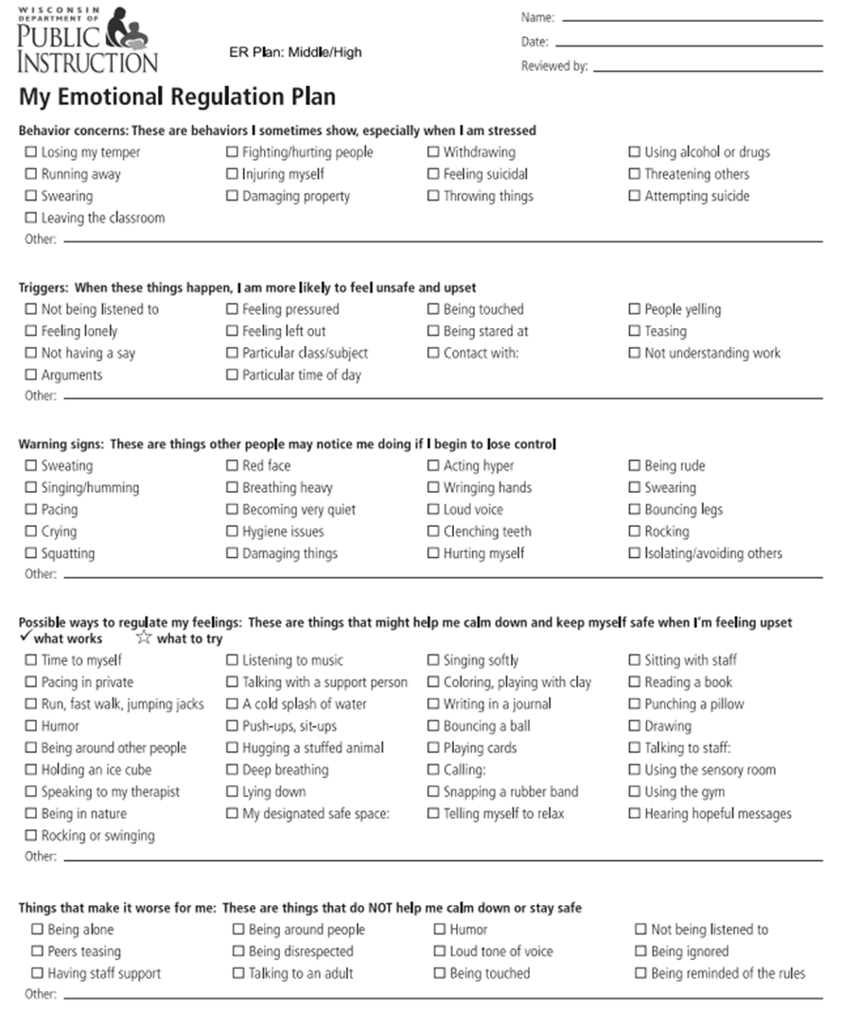

Slide 84
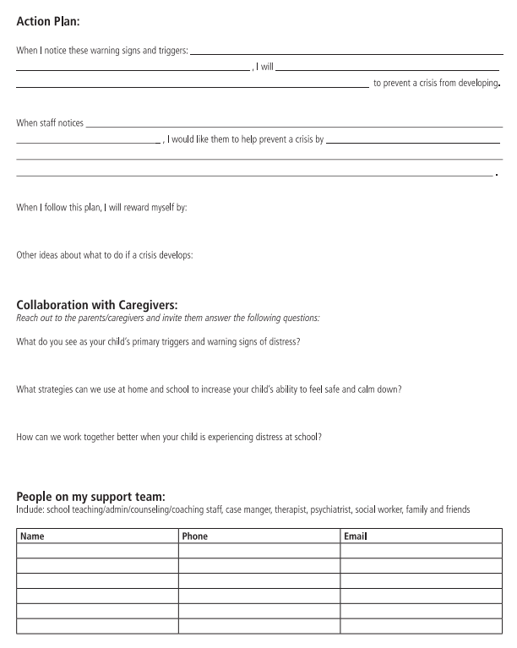

Slide 85
Adolescence
13-18 years of age

Slide 86
Adolescence
Intervention re:
Academics
Social skills
Personal care skills
Transition from care
anxiety middle school - Bing images
anxiety middle school - Bing images

Slide 87
What could we have offered Jane?
Continue to provide a safe, structured environment
Ongoing supervision
Encourage talents
Continue to address life skills
Monitor mental health
Sheltered employment/volunteer jobs
Education re: sex and birth control
Education re: being at high risk for developing a SU disorder

Slide 88
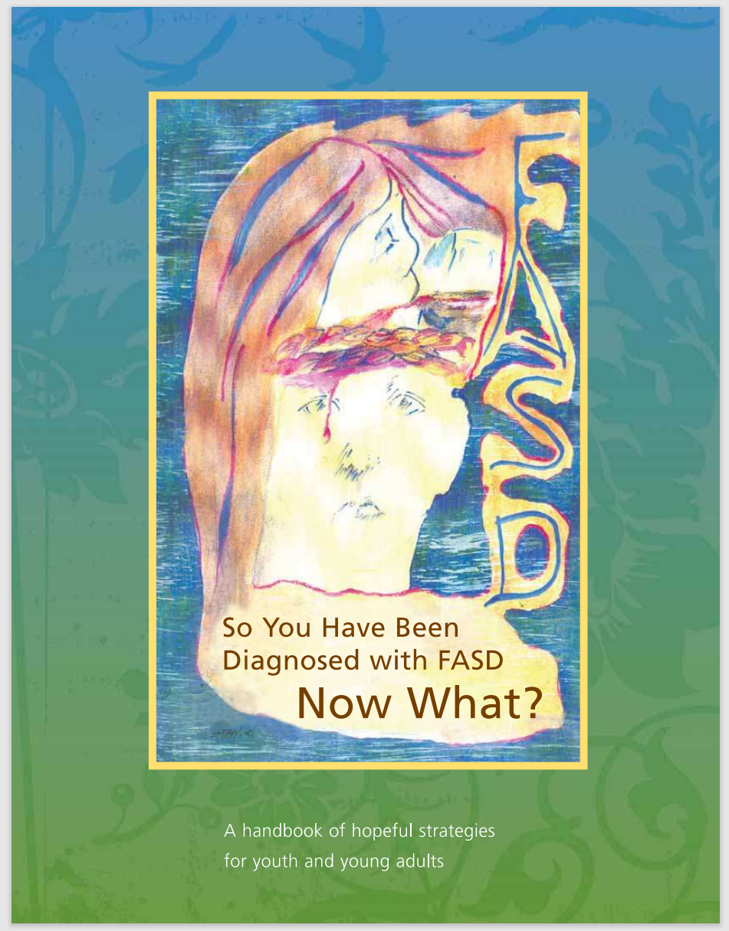

Slide 89
Do2Learn: Educational Resources for Special Needs
Do2Learn: Educational Resources for Special Needs

Slide 90
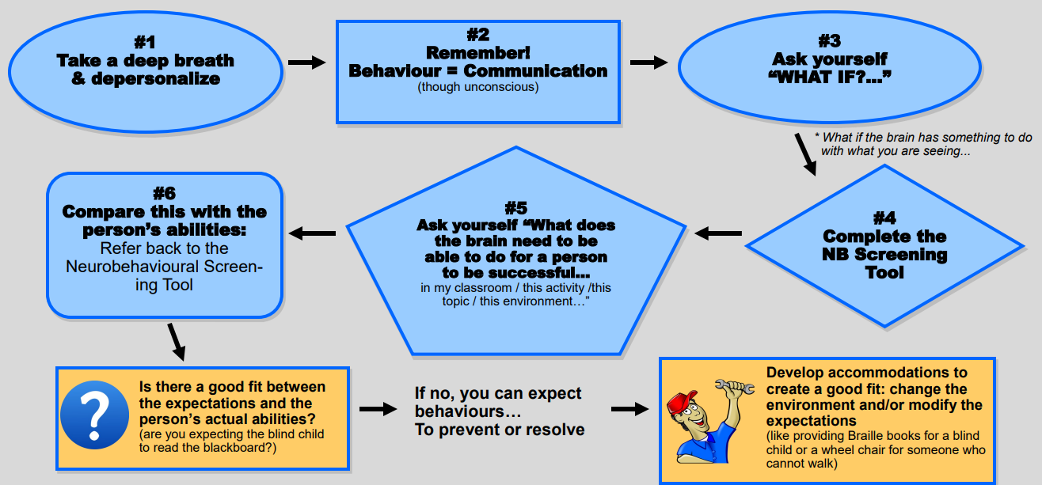
FASCETS
Using a neurodevelopme-ntal lens
Reframing
Brainstorming
Accommodations and Supports
Understand
Think Ahead
Adjust Expectations
Shift Approach
Plan Together
Cognitive
Supports
Framework
The Magic Keys

Slide 91
The “Big Picture”
Focus on the brain/body, not the person
Reframe … ask “what if” … understand … reinterpret
Consider “goodness of fit” between expectations and abilities
Provide support/accommodations aimed at cognitive abilities and struggles
Plan together (especially important for adolescents and adults)
Remember: safety and security are important
Build on strengths
Adjust expectations as needed
Apply the Magic Keys
Regulation is key
Make time for self-care
Big Picture Thinking in Business Course - Online Video Lessons | Study.com

Slide 92
www.cebc4cw.org
Notes:
This website is very important!!!! Go here.

Slide 93
Interventions: Early Years
Promising Research Evidence
Trust-based Relational Intervention (TBRI)
Promoting First Relationships (PFR)
Incredible Years (IY)
Circle of Security Program (COSP)
Safe Babies Court Team (SBCT)
Well-supported by Research Evidence
Attachment & Biobehavioral Catch-up (ABC)
In development
Families Moving Forward “Bridges”
Notes:
Found all of these interventions on the website
Maintaining parent-child relationship,
Here’s what _____

Slide 94
Interventions: Childhood
Promising Research Evidence
ALERT
Families Moving Forward (FMF)
GoFAR
Parents & Children Together (PACT)
Supported by Research Evidence
Math Interactive Learning Experience (MILE)
Tuning Into Kids (TIK)
Additional Resources
Trust-based Relational Interventions (TBRI)
Incredible Years (IY)
Circle of Security (CoS)

Slide 95
Interventions: Middle School Years
ALERT
Families Moving Forward
Good Buddies

Slide 96
Interventions: Adolescence
Promising Research Evidence
Parenting Wisely
Other
Tuning Into Teens (Australian sample)
Notes:
Interesting that there are fewer and fewer interventions as people get older…

Slide 97
Interventions: Adulthood
Parent Child Assistance Program (PCAP)
Step-by-Step
Notes:
Think about what we did for Jane. Here are some research-based resources that are available
PCAP is…
Step by step is….

Slide 100
References
Catterick, M., & Curran, L. (2014). Understanding fetal alcohol spectrum disorder: a guide to FASD for parents, carers and professionals. Jessica Kingsley Publishers.
Delahooke, M. (2020). Beyond Behaviours: Using Brain Science and Compassion to Understand and Solve Children's Behavioural Challenges. Hachette UK.
FASCETS RESOURCES - FASCETS
Grafe, S. (2003). Living with FASD. Ben Simon Press, Vancouver, BC.
Laugeson, E. A., Paley, B., Frankel, F., & O’Connor, M. (2011). Project Good Buddies Trainer Workbook. Atlanta, GA: US Department of.
Sheets, N. (2023). Essential FASD Supports: Understanding and Supporting People with Fetal Alcohol Spectrum Disorders. Outskirts Press.
Notes:
Olson, H.C., Pruner, M., Byington, N. & Jirikowic, T. FASD-informed care and the future of intervention. In: Abdul-Rahman OA, Petrenko CLM, editors. Fetal alcohol spectrum disorders: a multidisciplinary approach. Springer Nature; 2023; p. 269-362.

